Slide 1
Retail Data Analytics
Marwan Diab
June 26, 2022
Marawan.Diab@gmail.com 01026252078

Slide 2





WELCOME

Slide 3
Agenda
01. Introduction
02. (EDA & Data Manipulation)
03. Measures
04. Dashboard
05.Q & Recommendations

Slide 4

Introduction
You are provided with historical sales data for 45 stores located in different regions - each store contains a number of departments.
The company also runs several promotional markdown events throughout the year. These markdowns precede prominent holidays,
the four largest of which are the Super Bowl, Labor Day, Thanksgiving, and Christmas. The weeks including these holidays are
weighted five times higher in the evaluation than non-holiday weeks.
Within the Excel Sheet, there are 3 Tabs – Stores, Features and Sales

Slide 5
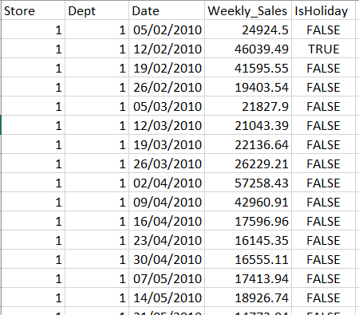
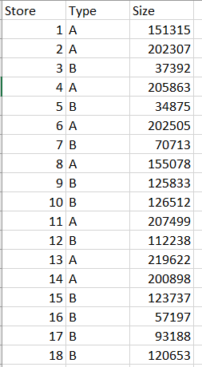
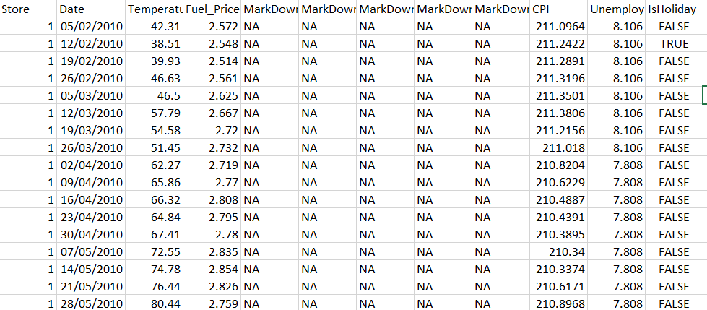
Data Sources
sales data-set
stores data-set
Features data set

Slide 6
Data Manipulation
Chane Date format from US TO UK
Replace “NA” to Null Values
Replace “NA” to Null in CPI
Fill Null With down after sort by date in CPI
Select datatype for some columns such as CPI from Text To Decimal
Create New Dimension “Dim_Date” for date by Dax

Slide 7
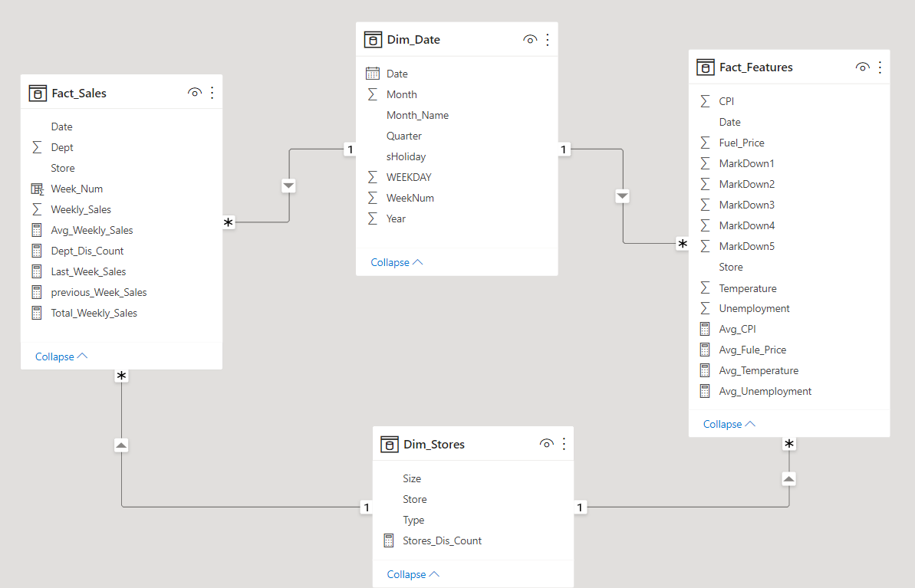
Data Modelling

Slide 8
Explore the Data
Time Frame
Outliers
Has Nulls Values
Sales from 2010-02-05 to 2012-11-01
Features from 2010-02-05 to 2013-7-26
Markdowns data is only available after Nov 2011,
The temperature column has some outliers as there are temperatures of 80 and > 40
But no temperature in Fahrenheit
Markdown from 1 to 5
CPI
Unemployment

Slide 9
Measure
Fact_Sales
Dept_Dis_Count = sum( 'Fact_Sales'[Dept])
Total_Weekly_Sales = SUM('Fact_Sales'[Weekly_Sales])
CROSSFILTER_Total_Weekly_Sales = SUMX(RELATEDTABLE(Fact_Features) ,[Total_Weekly_Sales])
Avg_Weekly_Sales =AVERAGE('Fact_Sales'[Weekly_Sales])
Last_Week_Sales = var CW = MAX(Fact_Sales[Week_Num])
RETURN
CALCULATE (sum (Fact_Sales[Weekly_Sales]), Fact_Sales[Week_Num] = CW)
previous_Week_Sales = var CW = MAX(Fact_Sales[Week_Num])-1
RETURN
CALCULATE (sum (Fact_Sales[Weekly_Sales]), Fact_Sales[Week_Num] = CW,ALL())
Dim_Date
Year = YEAR(Dim_Date[Date].[Date])
Dim_Date = CALENDARAUTO()
Quarter = "Q"&QUARTER(Dim_Date[Date])
WEEKDAY = WEEKDAY(Dim_Date[Date],1)
Month_Name =FORMAT(Dim_Date[Date].[Date],"MMM")
WeekNum = WEEKNUM(Dim_Date[Date].[Date],2)
Month = FORMAT(Dim_Date[Date].[Date],"mm")
Dim_Stores
Fact_Features
Stores_Dis_Count = DISTINCTCOUNT('Dim_Stores'[Store])
Avg_CPI = AVERAGE('Fact_Features'[CPI])
Avg_Unemployment = AVERAGE('Fact_Features'[Unemployment])

Slide 10
Questions
What type of big and small size stores?
What type of store is the most selling?
What is store has most selling?
What is departments has most selling?
Does Black Friday affect sales?
Does store size affect sales?
Does Christmas affect sales?
Does Markdown affect sales?
What is top 10 Weeks Sales ?
How many retailers?
What is the total amount of sales?
What is average CPI?
How many Departments?
Holiday sales?
How much did last week's sales differ from this week’s?
what is the last week sales by holiday ?
what is the weekly sales in holiday by Department ?
what is the weekly sales in holiday by Type ?

Slide 11
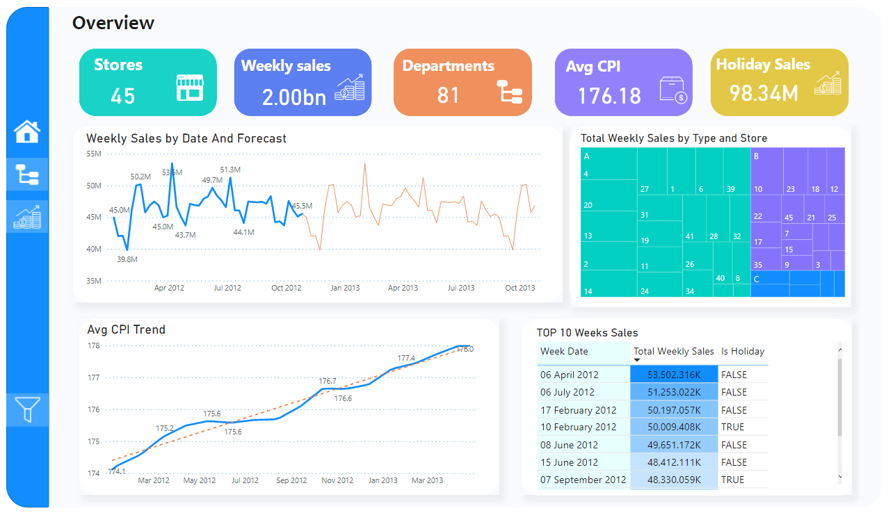
Dashboard (Overview )
https://www.novypro.com/project/retail-sales-analysis

Slide 12
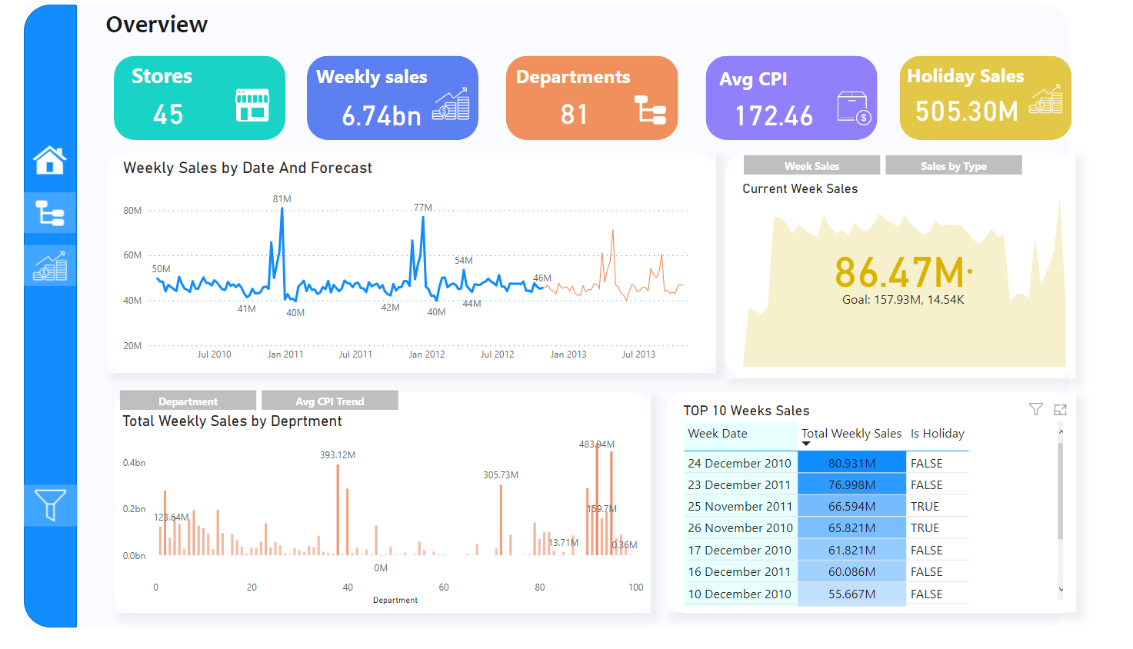
Dashboard (Overview )
https://www.novypro.com/project/retail-sales-analysis

Slide 13
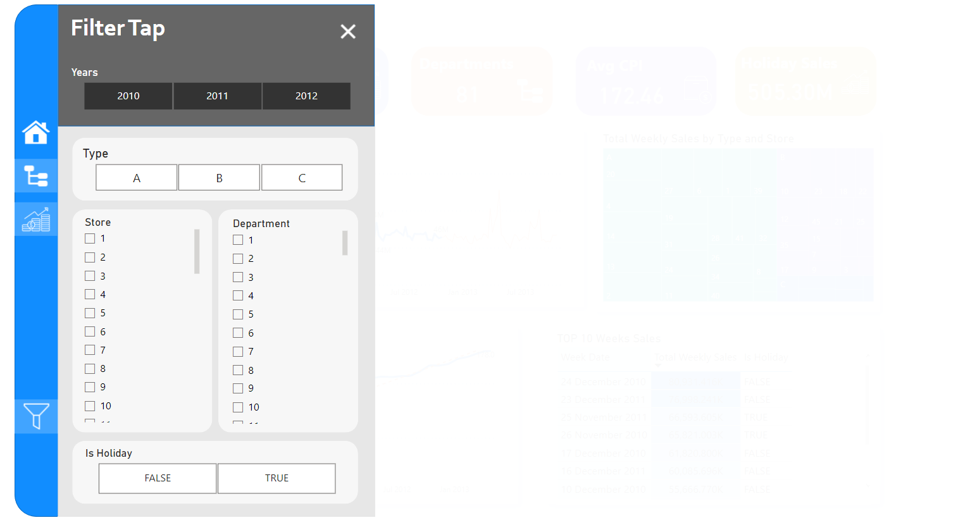
Dashboard ( Filter Tap)
https://www.novypro.com/project/retail-sales-analysis

Slide 14
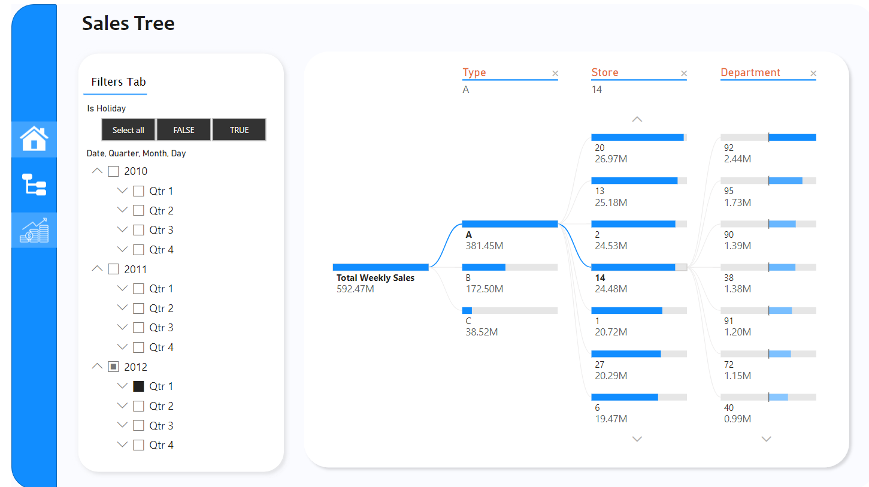
Dashboard (Sales Tree)
https://www.novypro.com/project/retail-sales-analysis

Slide 15
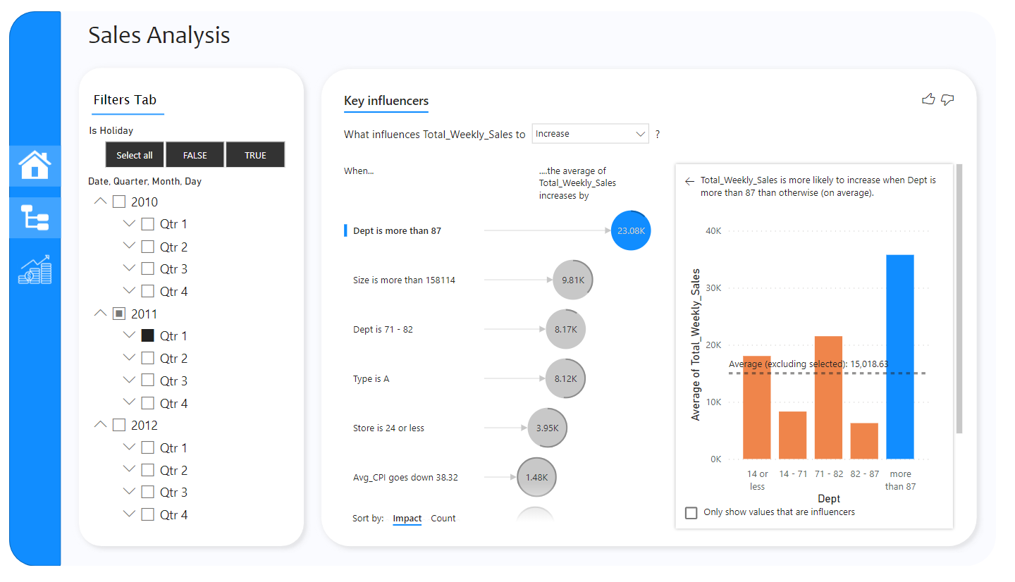
Dashboard (Sales Analysis)
https://www.novypro.com/project/retail-sales-analysis

Slide 16

Recommendations
On Christmas and Black Friday, sales every year increase suddenly, so we can display some products that sell less, and prepare the big stores for this crowd
6/4/2012 There is a noticeable increase in sales this week, we have to find out the reason
At the beginning of the new year, sales are at the lowest level in all stores. This date can be used to arrange and reorganize stores
Since there aren't many C-type stores, we can open a lot of them as their sales grow over time.

Slide 17

Thank you

